Slide 1

RICHARDS BAY RECONCILIATION STRATEGY STUDY
Presented by:
Erik van der Berg
Aurecon
22 October 2013

Slide 2
PRESENTATION TITLE HERE (if needed)
Sub-Title here (if needed)
Presentation Content
Need for the study /objectives
Background to the study
Scope of the study
Study Administration

Slide 3
Need for the study & study objective

Slide 4
Need for the study
Need for comprehensive Recon Strategy was identified in prioritisation process for Eastern Planning Region
Potential significant further investments in the IDZ – existing available supplies would come under pressure if these proceed
Strategy needed to ensure the timely implementation of interventions to reconcile system supply with demand

Slide 5
Objective of the study
Development of a strategy for interventions to meet possible water requirements in Richards Bay & surrounding towns for at least 25 years
Determine potential options / groups of options – that form reconciliation scenarios – each of which could potentially be implemented
Identify degree of information needed & time frame to implement the strategy

Slide 6
Background to the Study

Slide 7
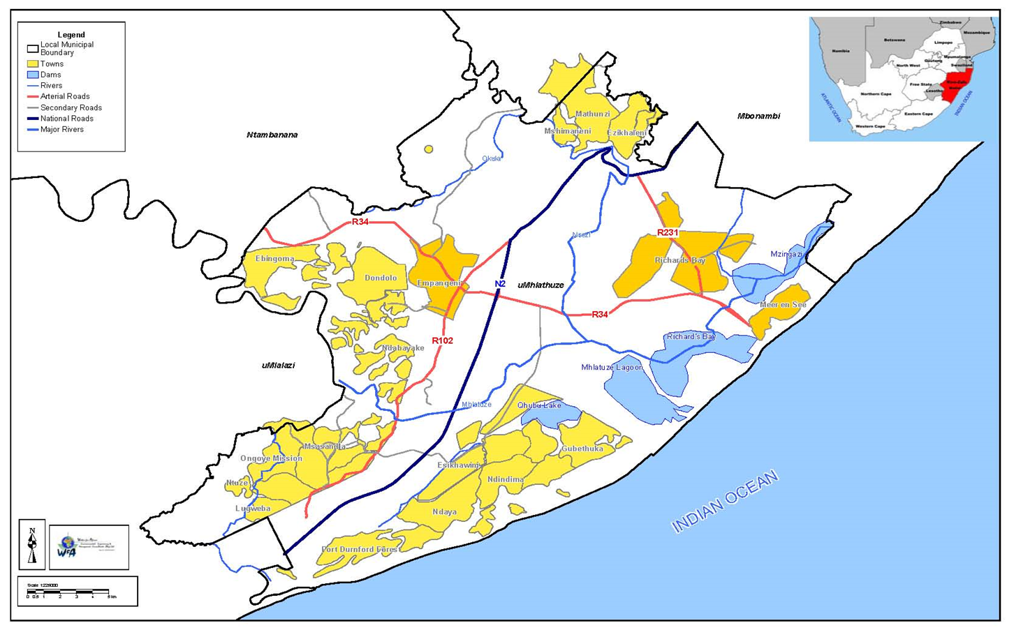
Locality Map of the City of uMhlathuze Local Municipality System

Slide 8
Schematic layout of the Mhlatuze River system

Slide 9
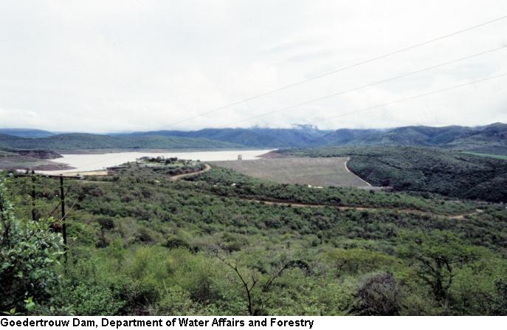

Slide 10
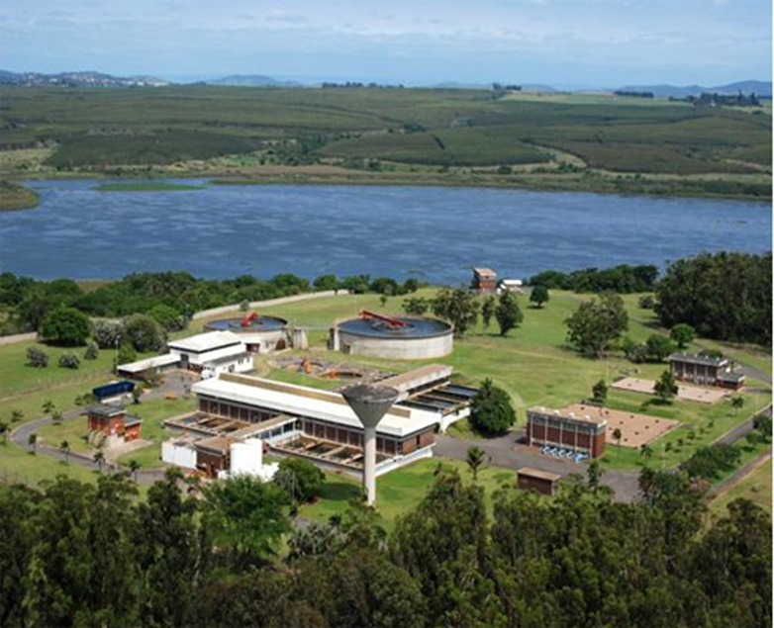
Nsezi Water Treatment Plant – Mhlatuze Water

Slide 11
Other relevant studies
Mhlatuze Water Availability Assessment Study by WRP, including updated system modelling
Ongoing Classification Study by Tlou Consulting
Ongoing All Towns support study by Tlou Consulting
Ongoing Verification and Validation study / Compulsory Licensing
Northern KwaZulu-Natal Water Resources study including Mfolozi catchment
Groundwater resource assessments
uMhlathuze Municipality Water Efficiency Plan
Relevant public processes
Studies included in the TOR (included in today’s Agenda)
Other?

Slide 12
Scope of the Study

Slide 13
Phase 1: Inception
Project kick-off
  Confirm study boundaries
Assemble and assimilate information
  Including liaison with ongoing studies’ staff
Review & consider study proposal, programme, budget & deliverables
Prepare Inception Report

Slide 14
Phase 2: Tasks
Development Scenarios & Water Requirements
Water availability assessment
Intervention options
Value of water assessment
Reconciliation Strategy development & reporting
Environmental Considerations – Reserve review
Public participation & co- ordination

Slide 15
Development Scenarios & Water Requirements
Tasks
Close interaction with key stakeholders
Evaluate / confirm existing water requirements patterns
Develop range of plausible development scenarios / Evaluate water requirements growth drivers
Forecast future water requirement scenarios
Urban (potable / non-potable)
Significant growth being experienced, appr. 2.5% p/a
Irrigation
Situation assessment to be done
Identify potential for irrigation allocations to be taken up for urban use

Slide 16
Water Availability Assessment
Surface water
Obtain/Review Mhlatuze Water Availability Assessment Study
Groundwater
Evaluate past groundwater resource/availability assessments
Water Balance
Determine water balance shortfall/surplus

Slide 17
Intervention Options
Identify long-list of options
Screen out obviously unrealistic options
Comparative evaluation of short-listed options at desktop level
  Documented according to a standardised template
  Salient technical, financial, environmental, social, economic features

Slide 18
Range of Intervention Options
Improved water use efficiency
Improved operational efficiency
Surface water augmentation
  Thukela River
  Mfolozi River
Groundwater augmentation
Re-use of water
Desalination of sea water
Water trading?

Slide 19
Scenario Planning
Define future water balance scenarios in close co-operation with stakeholders
Obtain Water Resources Planning Model and get operational
Calculate sequencing for agreed range of development scenarios with the Water Resources Planning model
Present scenario results and reach agreement on acceptable future scenarios

Slide 20
Value of Water Assessment
Determine the value of a unit of water used by different industries
Calculate both monetary and social costs in financial terms
Determine ‘one’ value for a unit of water

Slide 21
Reconciliation Strategy Development & Reporting
Reconciliation Strategy development
Identify possible actions (e.g. feasibility studies) and timing
Allocate responsibilities for actions
Develop Draft Action Plan and obtain key stakeholder comments
Report on Reconciliation Strategy
  Main Report summarising study activities
  Describe process, study tasks & findings, recommendations and Action Plan

Slide 22
Environmental Considerations – Reserve Review
Extensive work on Ecological Reserve for the Mhlatuze River done
Classification of the resource not done according to published Water Resources Classification System (DWA, 2006)
DWA currently undertaking full Classification which will include a revision of the Reserve for the Mhlatuze – but this contract is “on ice”
Review of the Reserve determination, classification & outstanding necessary work to reach a desired Management Class
Work closely with CD:RDM of DWA
Section of Mhlatuze River below Goedertrouw Dam to be addressed (for surface water quantity & quality)

Slide 23
Public participation & co- ordination
Compile stakeholders database
Liaison with public, media & stakeholders
Public newsletters (2) circulated before public meetings
Public meetings
  At commencement of the study to present the Inception Report
  Near completion of the Recon Strategy to present the Draft Findings

Slide 24
Capacity Building & Training
  In-project training
  Up to 10 DWA KZN office interns or learner technicians
  Training in aspects of Recon Strategy Development as needed
  Couple to study ‘events’ such as workshops

Slide 25
Study Administration

Slide 26
Study team
Firms | Responsibility
Aurecon | Study Management Inception Phase Development scenarios & Water Requirements Water Availability and Balance Intervention Options Evaluation of the value of water - social Scenario evaluation Strategy Development & Reporting
Institute of Natural Resources | Environmental considerations - Mhlatuze Resource Classification Review
Geomeasure | Groundwater
Nemai Consulting | Public Participation and Co-ordination
Willem van Zyl | Evaluation of the value of water - financial

Slide 27
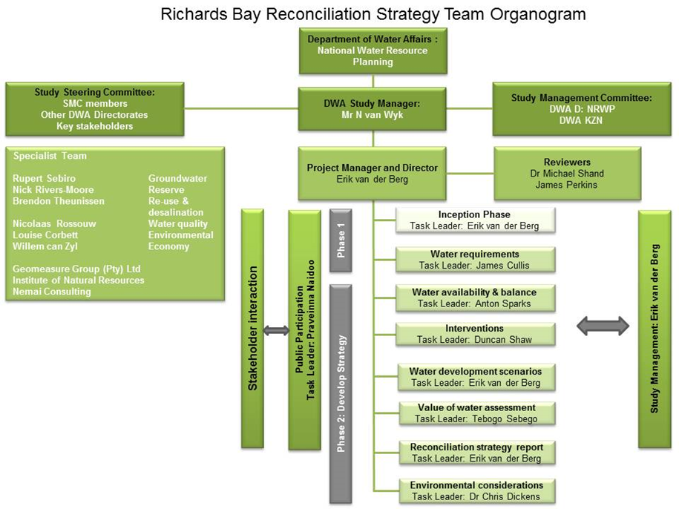

Slide 28
Programme
2-Year study
  Inception Phase: 3 months
  Main study: 21 months

Slide 29
Study meetings
  Study Steering Committee meetings
  Study Management Committee meetings

Slide 30
- Thank you -

